Slide 1

INFO 6105 Final Group Project: Natural Images By Team Red Sox: Kiran Kumar Gangadharaiah Preeti Kori Shail Parikh Tingyu Lui

Slide 2

Problem statement
How do humans recognize a tree or a river? We are good at categorizing scenes based on the semantic representation and object specificity, but we know very little about the processing and encoding of any scene categories in the human brain.
In this problem, we are provided with a Kaggle dataset which is a compilation of 6899 images from 8 different classes namely airplane, car, cat, dog, flower, fruit, motorbike and person. The task is to identify which class can the image be classified into.

Slide 3

Approach
According to the problem statement, the task is a perfect example of image classification of big data.
Image classification - define a set of target classes (objects to identify in images), and train a model to recognize them using labeled example photos
The two most common approaches for the image classification are using a DNN or CNN model.
We have Fast AI approach to check whether the data is balanced or not

Slide 4
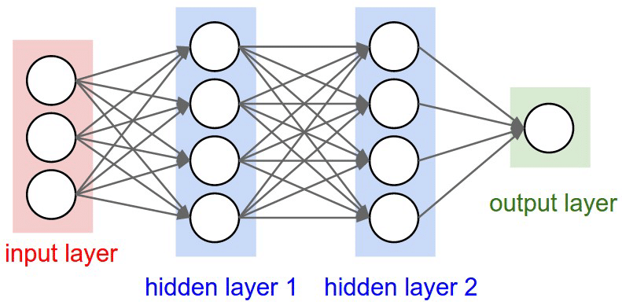
Brief about the Libraries and methods
DNN Model – DNN stands for deep neural networks model. The basic task of any DNN model is to find the correct mathematical manipulation which can turn the input into the output.
It consists of multiple layers between the two outer layers namely input and output layer.
DNN MODEL

Slide 5

Overview of Keras Library
Keras is an open source python library for developing and evaluating deep learning models.
Its task is to wrap around the computational libraries such as TensorFlow and allowing one to define and train the neural network models using no more than just a few lines of code.

Slide 6
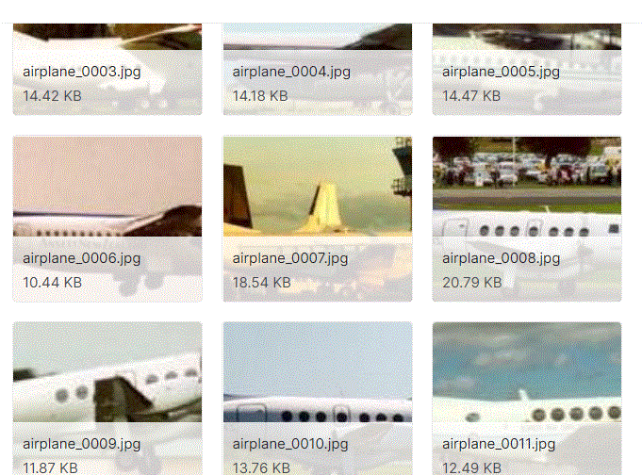
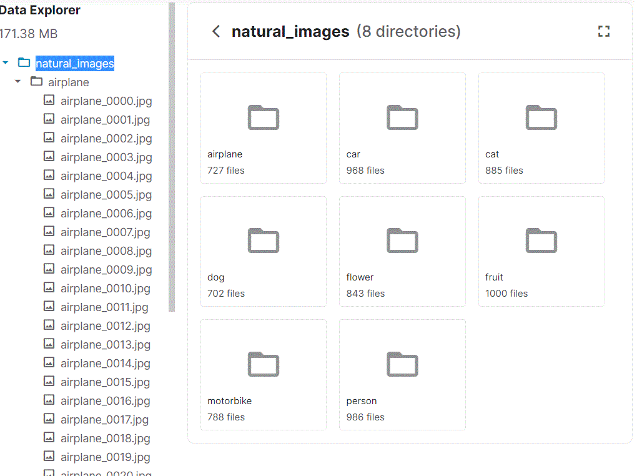
A Preview of the Image dataset:

Slide 7
In the next following slides we will go through step by step approach of the image classification of the given dataset.

Slide 8
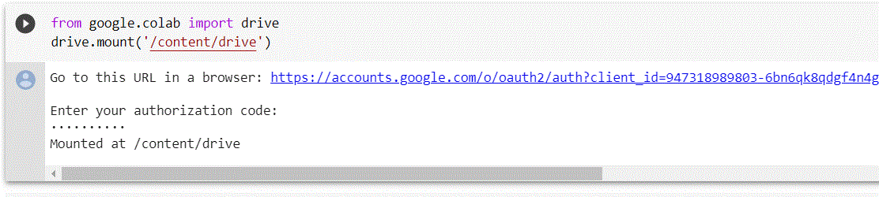
As we are using google colab to solve the image classification problem, first the data need to be mounted on the google drive and then imported for preprocessing.

Slide 9
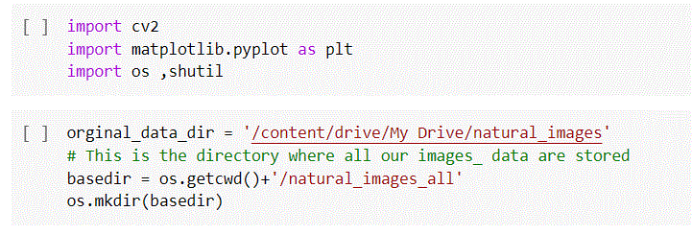
Step 1- Importing all the modules and functions for plotting ,copying and working on image files. Step 2 – assigning location of the original data directory and returning the current working directory in the operating system.

Slide 10
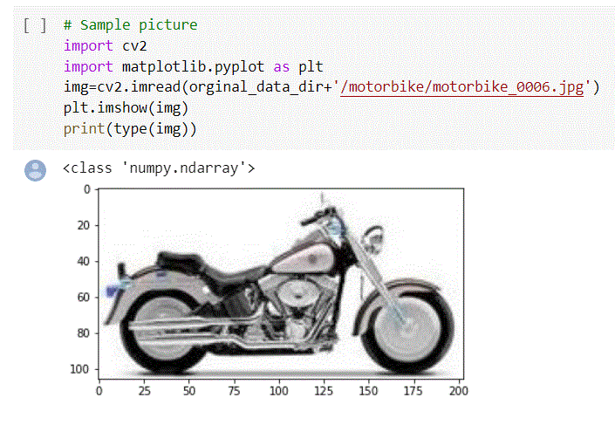
Importing a sample image from the dataset library

Slide 11
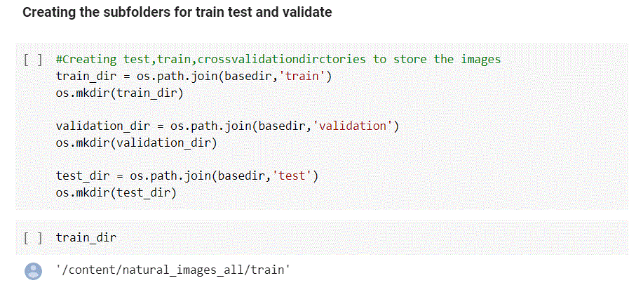
Further, we will create subfolders of the dataset namely train, test and validation. Test data is used for evaluation and finding the best fitting mode, train dataset is the part on which the predictions will be made, and validation data is a sample data held back from training your model.

Slide 12
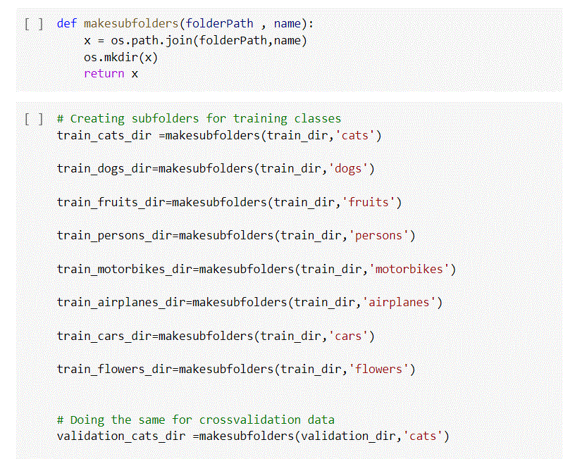
Making subfolders of training classes of images for each set of data(train, test and evaluate)

Slide 13
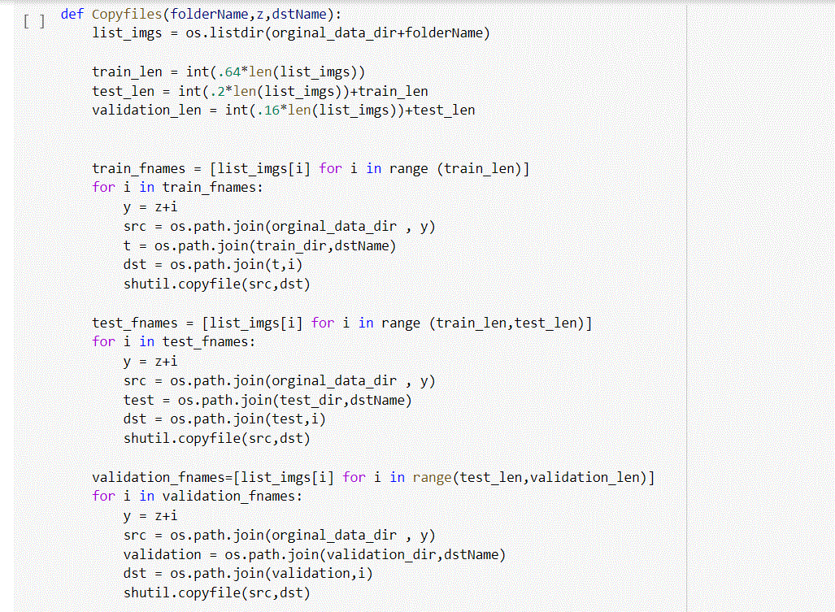
Copying the image files in all 3 data using the os and shutil module. Shutil function provides the ability to copy and removal of files.

Slide 14
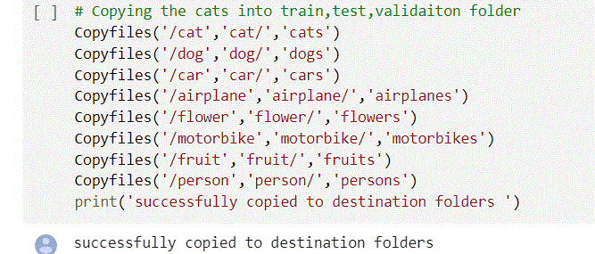
Copying the specific image folders to their destination folder location.

Slide 15
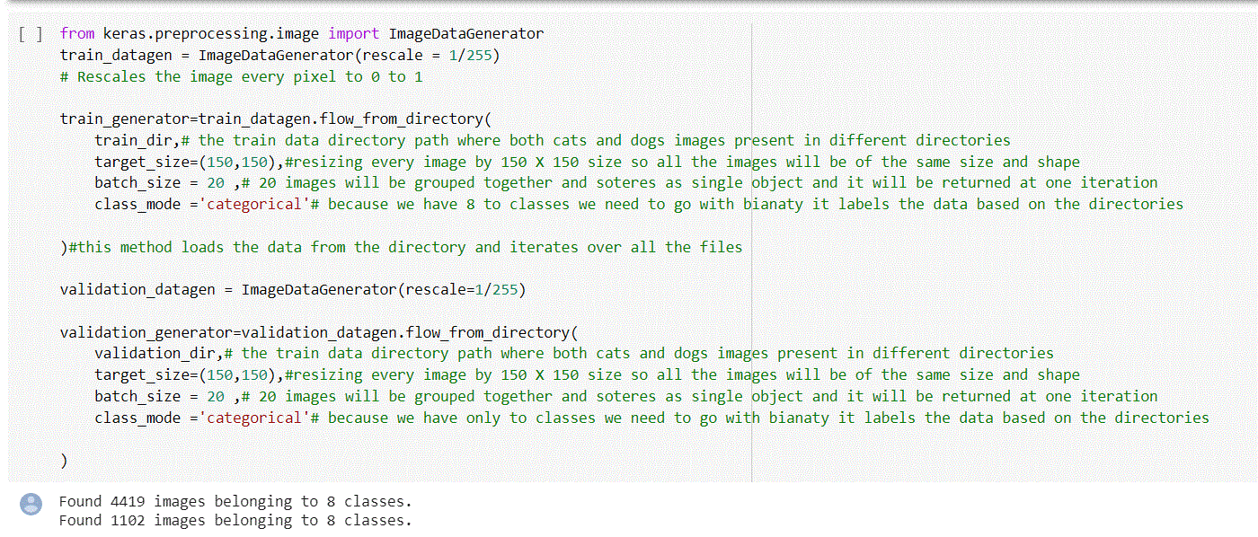
Keras ImageDataGenerator
Here, keras is a library and this particular function will be used to fit models using image data augmentation. It is usually used to expand the training dataset in order to improve the performance and ability.
It performs the functions like loading data, iteration and rescaling for both train and validation data.

Slide 16
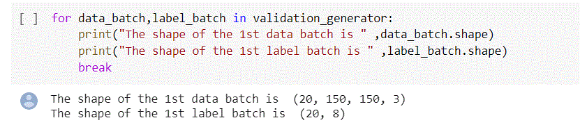
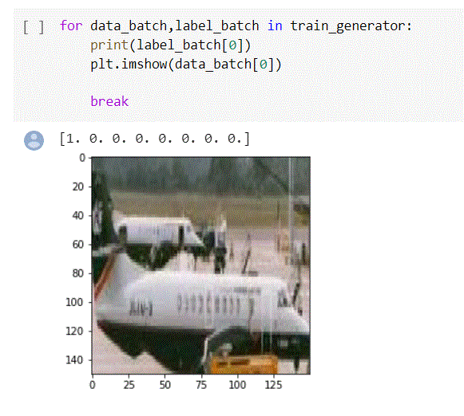
The .shape function returns the dimensions of the file in the form of integers for both data and label.
Plotting the same data in a graph:

Slide 17
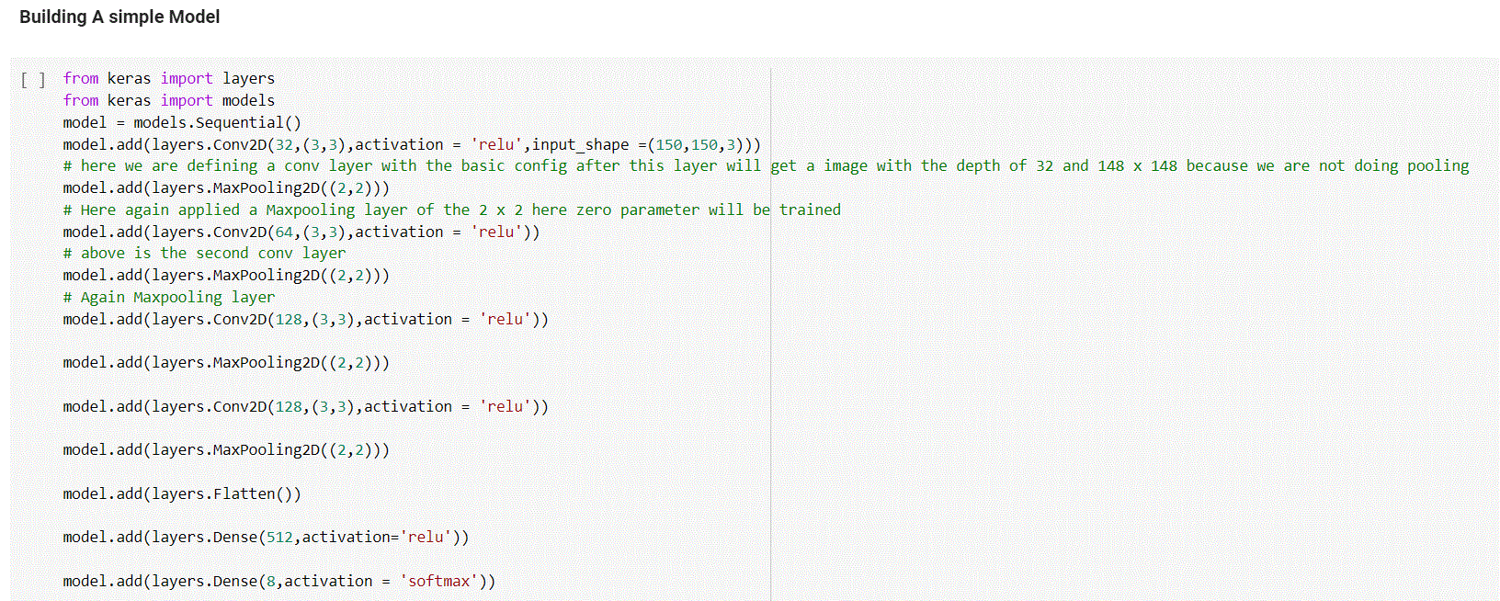
Training our model using the keras library:
This consists of importing layers and models from keras, defining new layers and adding them to the model.

Slide 18
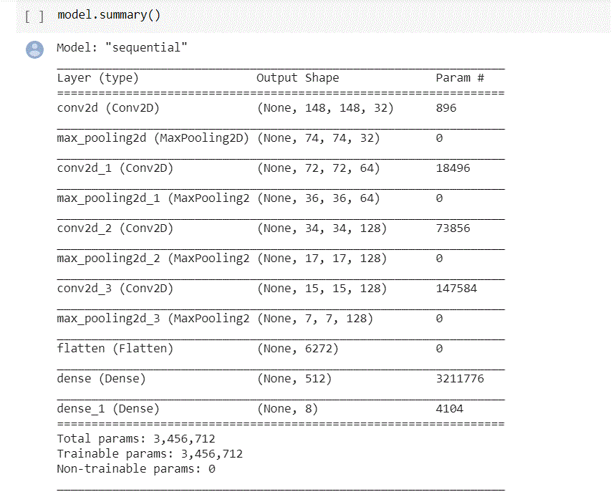
The detailed summary of the trained model can be seen as below using model.summary() It shows the layer name,its dimensions with parameters.

Slide 19
Compile function defines the loss function. We can compile a model multiple times and can be used on a train data because training uses the loss data and the optimizer.

Slide 20
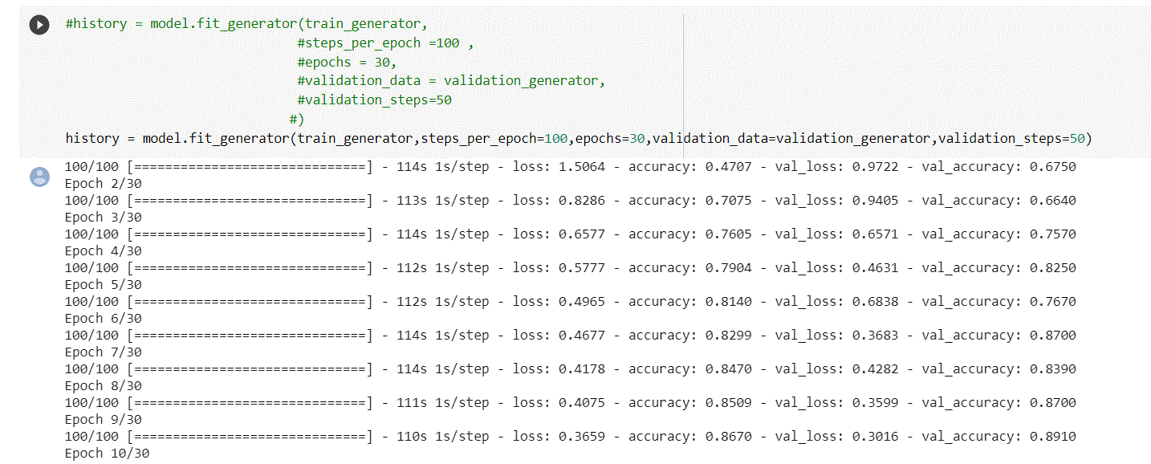
Making epoch versus train set accuracy, and validation set accuracy

Slide 21
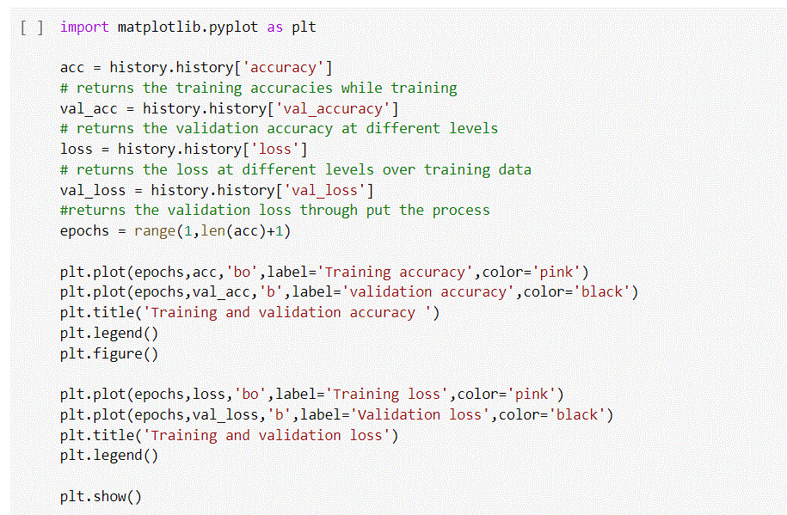
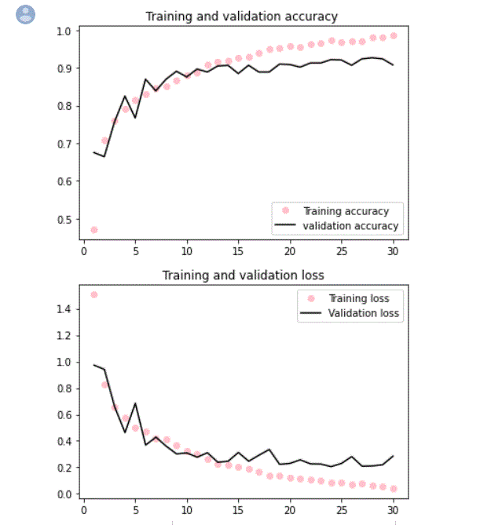
The plot of train and validation accuracy will be as below:

Slide 22
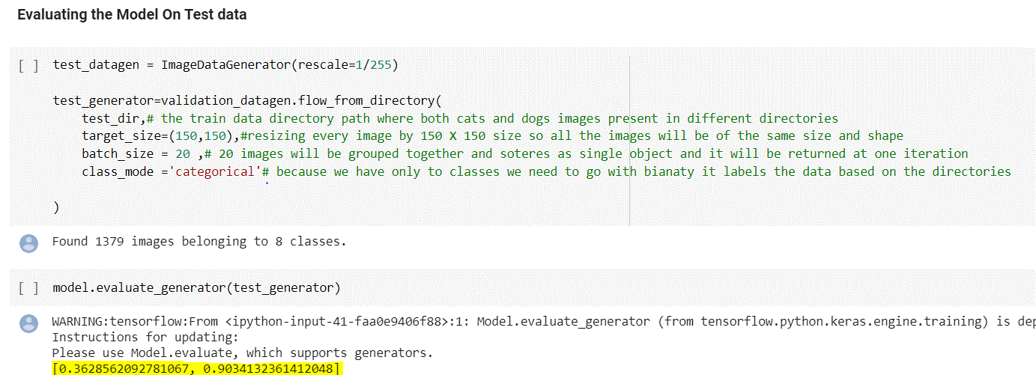
EVALUATION:
Evaluating the model on the test data includes test directory, resizing images to same size, grouping together the data into batches and assigning a class mode to the data.
The model.evaluate_generator will predict the accuracy on the test data.
For our model, the accuracy received was 90%.

Slide 23
Adding Regularization techniques and data augmentation techniques to improve the performance of the model.

Slide 24
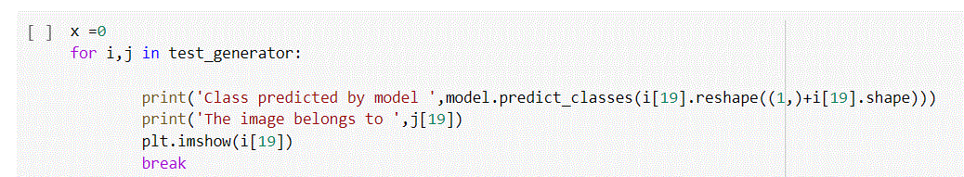
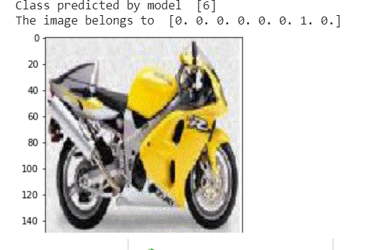
Explain a predicted model and where the image belongs to by plotting a graph. It belongs to motorbike

Slide 25
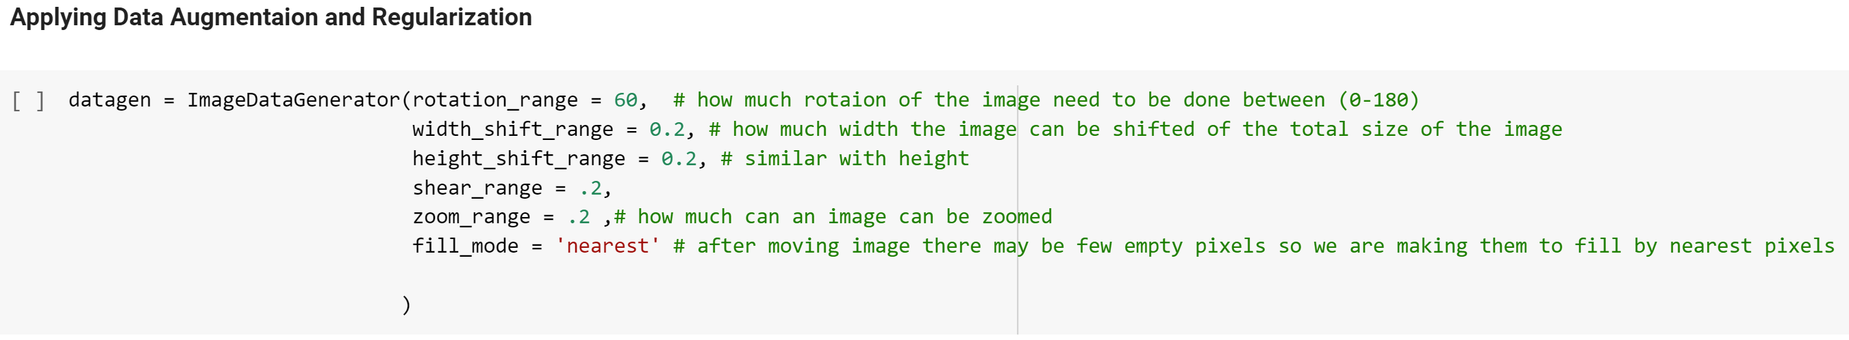
As the model created was an overfitting, data augmentation and regularization needed to be applied on the training set. Shifting the data under data augmentation will generate hundreds of new data to train further.

Slide 26
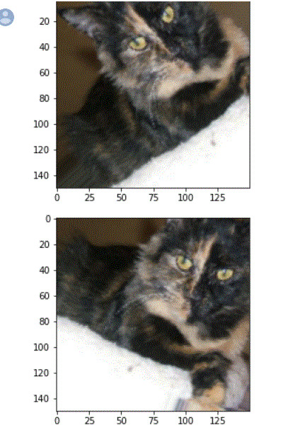
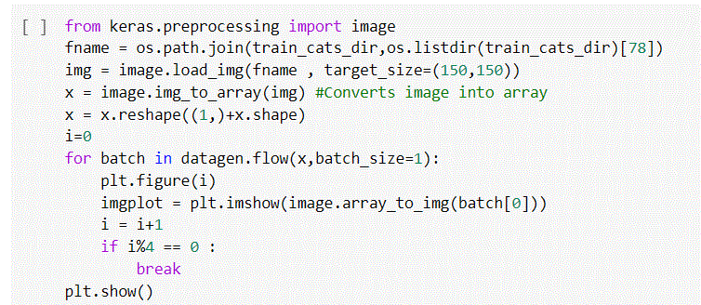
Displaying some randomly generated images on a plot graph for the newly trained augmented data.

Slide 27
Performing all the previous steps that were performed on the test dataset on the new augmented data.

Slide 28
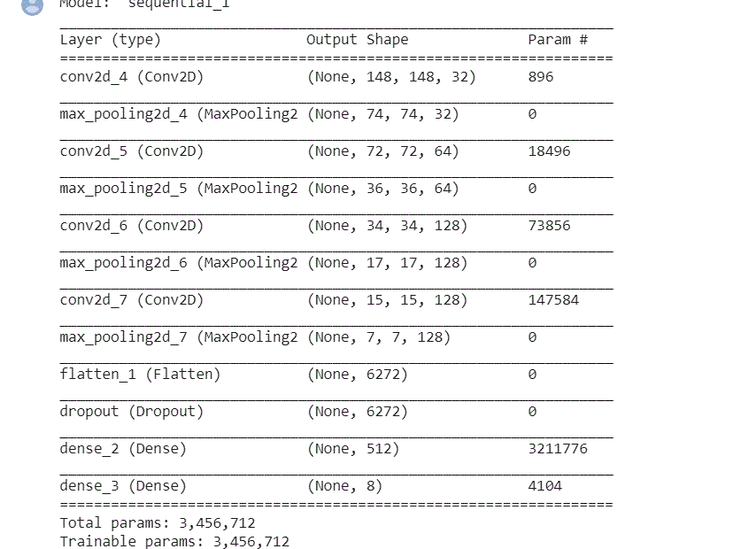
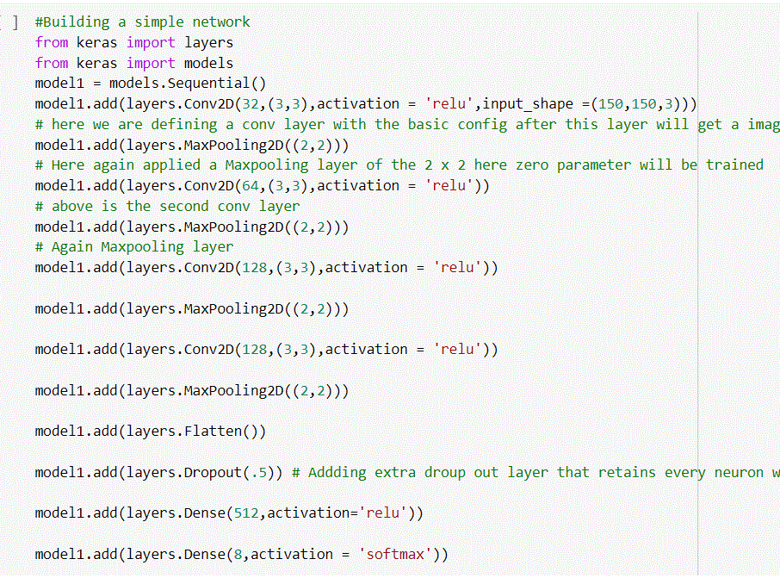
Defining a new network consisting of layers to train the augmented data.

Slide 29
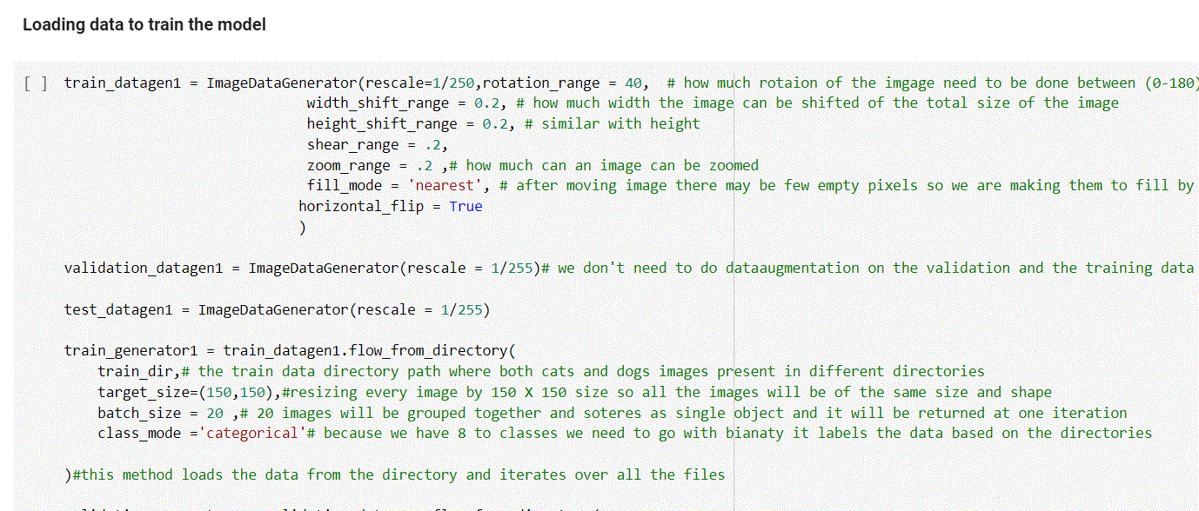
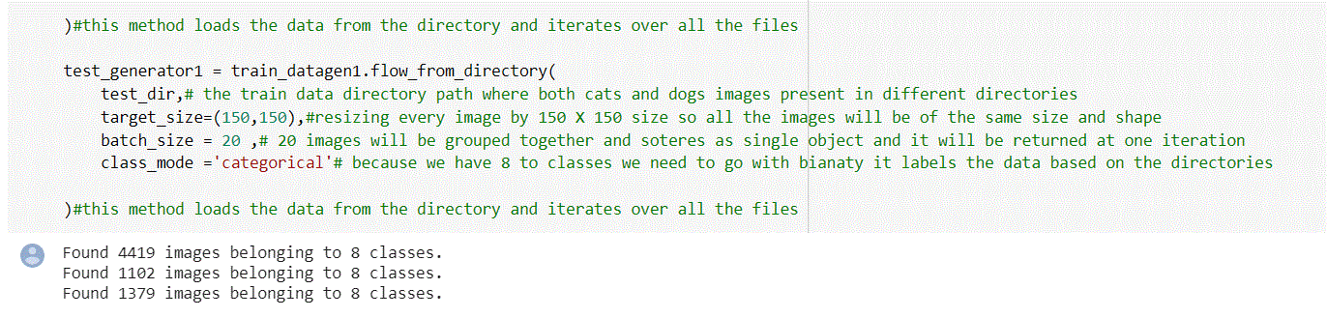
Loading data to train the model. Performing image data generator steps on all 3 test, train and validation datasets.

Slide 30
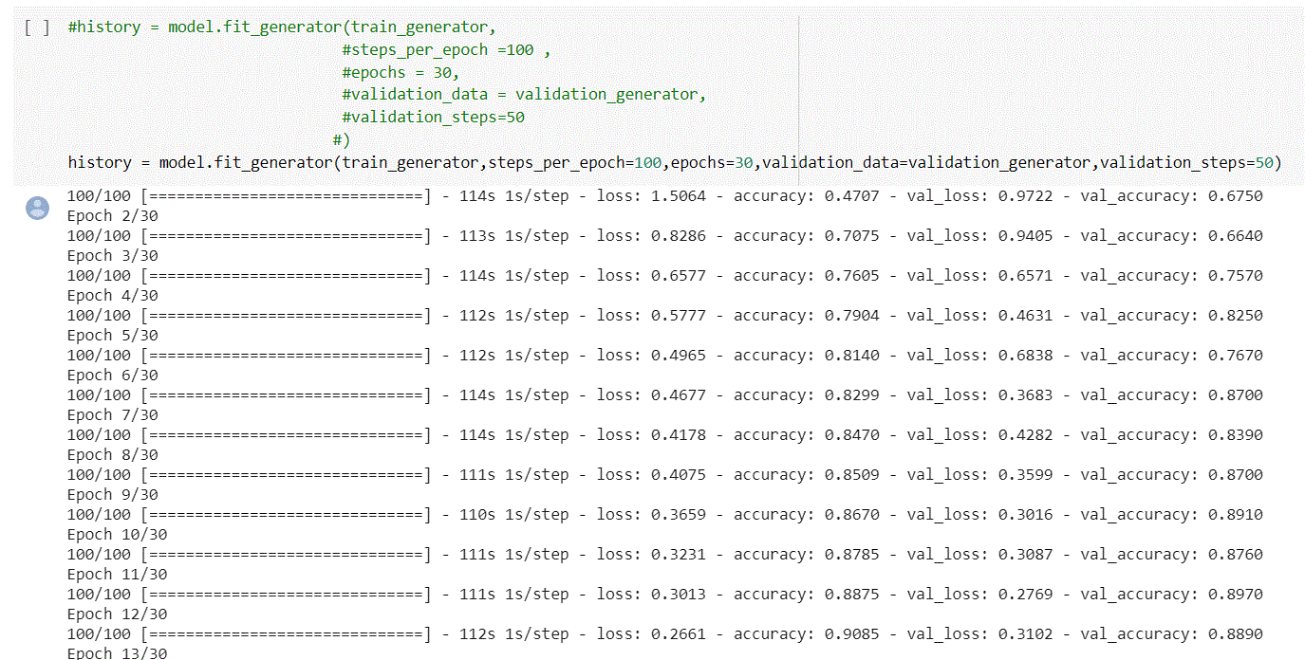
Making epoch vs train and validation set accuracy for augmented data

Slide 31
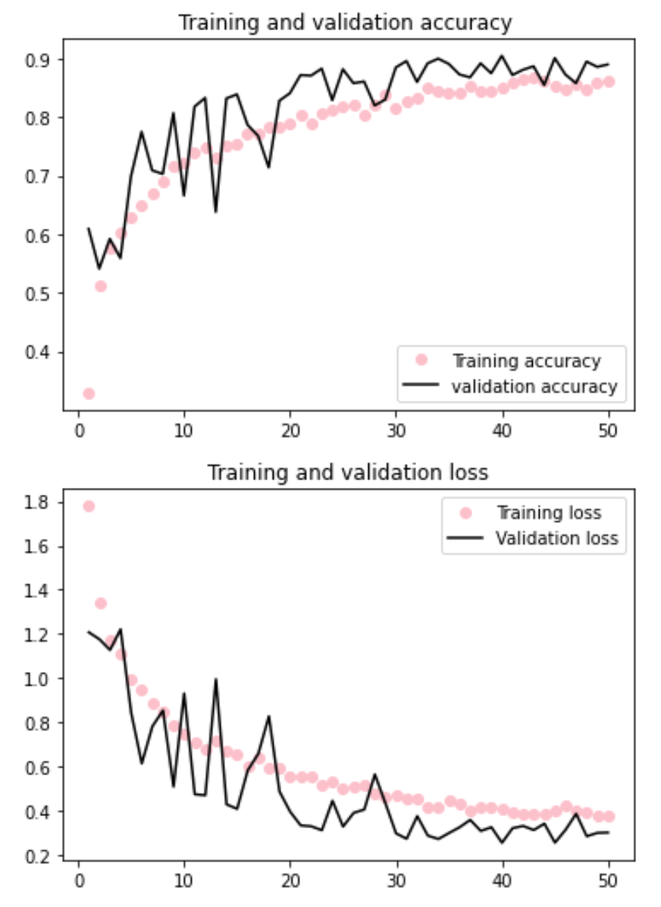
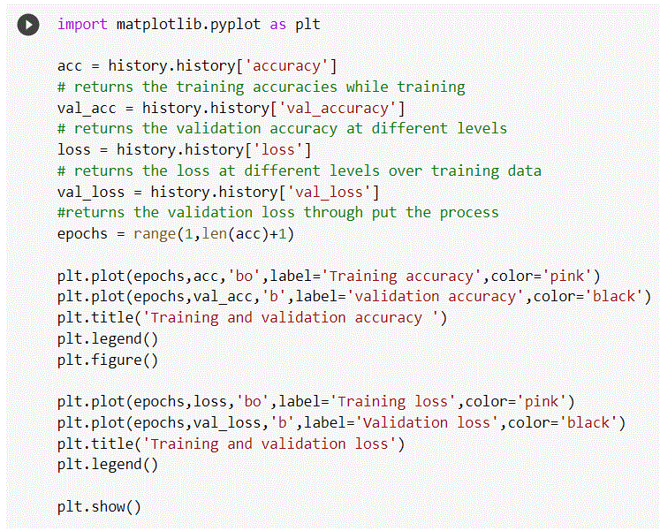
Plotting the training and validation accuracy curve:

Slide 32
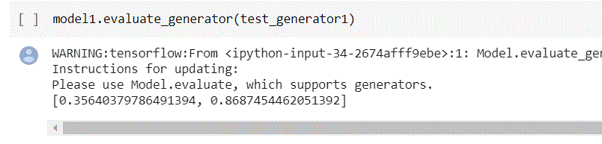
Generating the accuracy for the model using the newly formed augmented data. The model has a good accuracy of 86% on the testing data

Slide 33
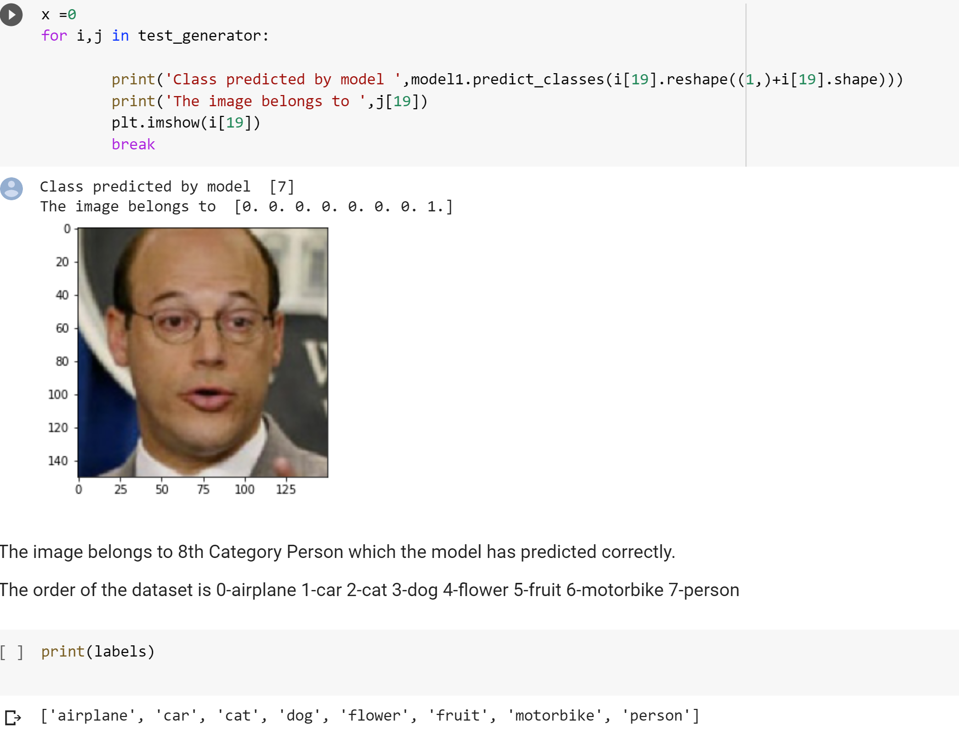
Getting the accurate prediction using the model built:

Slide 34
Thank You!

